Slide 1
GLOBAL
Clearinghouse Systems
YOU THINK OF PORTS? WE HAVE SOLUTIONS
SHUAIBA CONTAINER TERMINAL

Slide 2
INDEX
1. OVERVIEW
2. OPERATIONS
3. MAINTENANCE
4. SAFETY & SECURITY
5. TRAINING
6. STATISTICS
7. REVENUE
8. FUTURE IDEAS

Slide 3
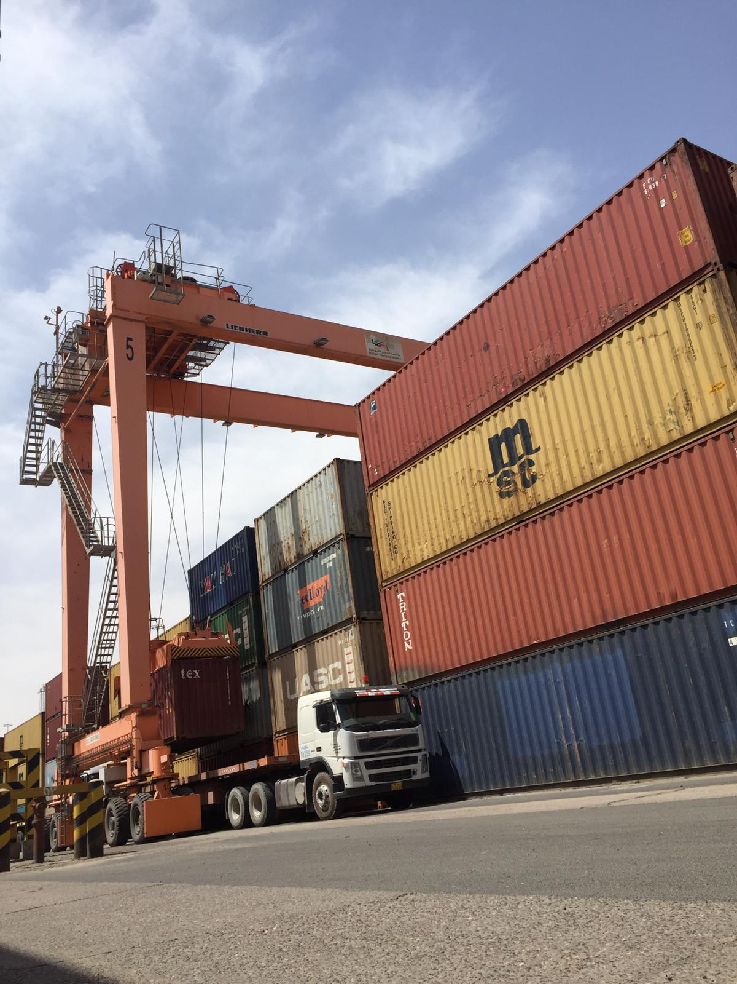
SHUAIBA
OVERVIEW

Slide 4
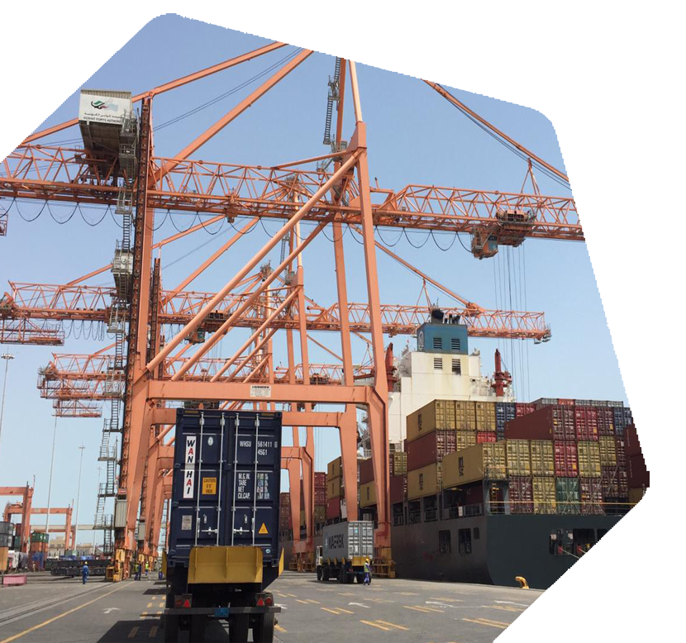
OVERVIEW
Shuaiba port is located in Al-ahmadi area about 45 kilometers south of Kuwait city at latitude 29 2 minutes and 26 seconds north, and longitude 48 10 minutes 56 seconds east.
SHUAIBA Container Terminal
The port contains berths for commercial goods and others for
containers berths, Shuaiba port encompasses 20 berths with a
total length of 4068 meters and depths ranging from 7.5 to 14
meters, including 4 berths numbers 15,16,17,18. Dedicated to
container handling. These four berths with 157, 211, 250 and 278 meters each. And with yard capacity of
23646 Teus, and 315 Reefer plug point.

Slide 5
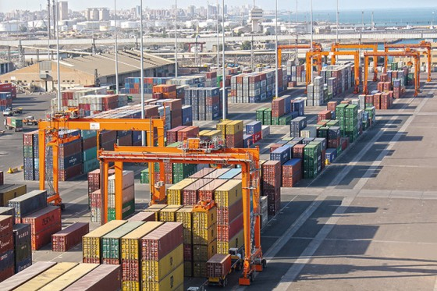
About Our Terminal
Yard capacity
23,646 TEU
Annual terminal capacity
approx. 503,550 TEU
Berth Length served by 7 STS
880 Meters
Equipment for yard purposes
20 RTG, 5 RST and 19 EH

Slide 6
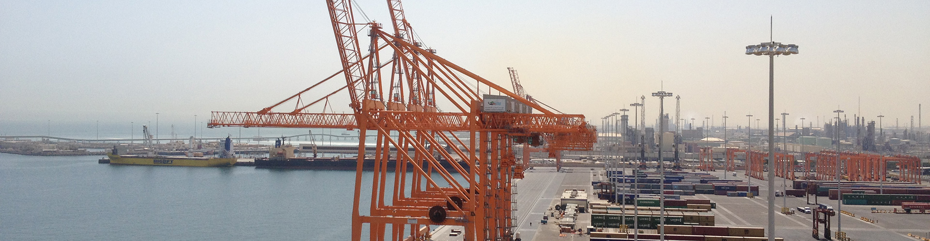
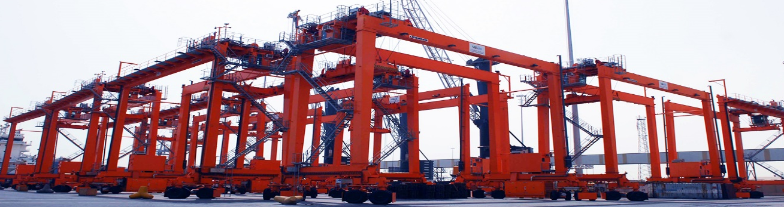
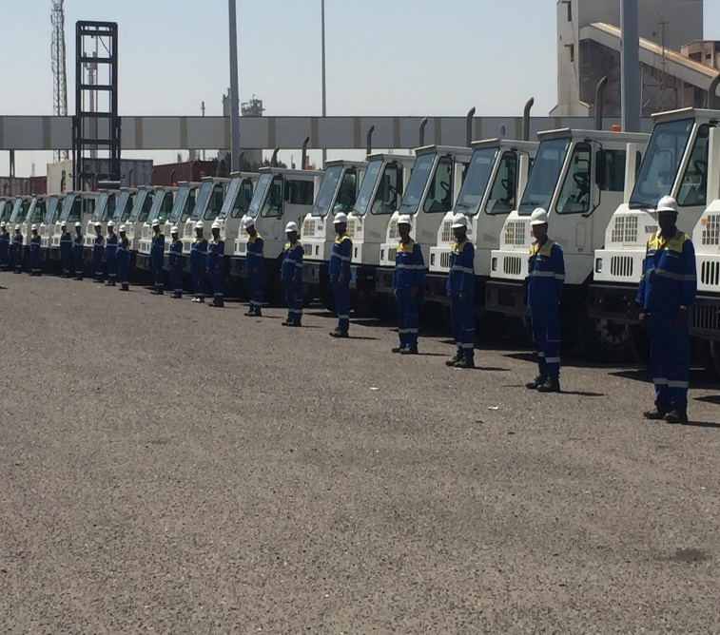
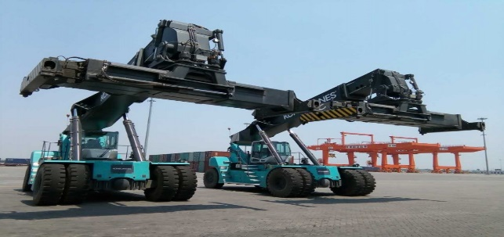
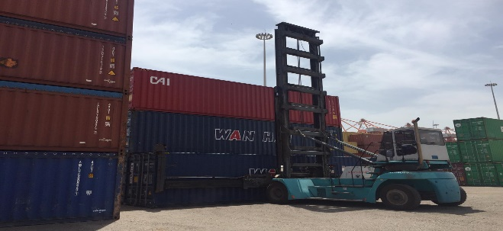
Equipment
7 STS
20 RTG
5 RST
19 ECH
38 TT

Slide 7
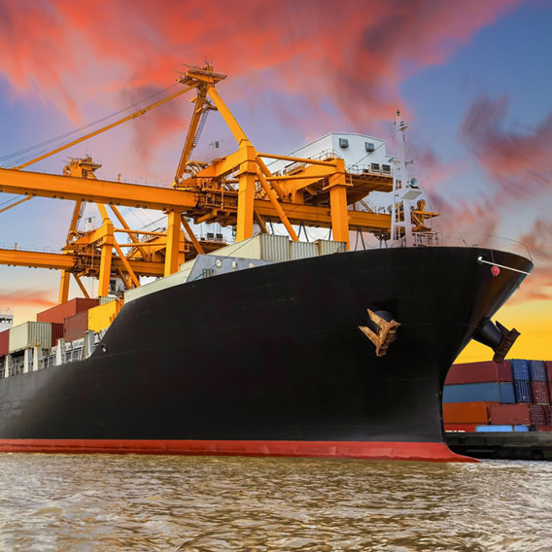
Operations

Slide 8




Areas of Operations
Vessel and yard planners to pre-plan all the container terminal operations along with equipment controller to handle the movement of equipment
Vessel Operations
Yard Operations
Gates Operations
Planning
Handling containers from/to Vessels using the gantry cranes, VMT and Manpower.
Stacking containers in yard either full or empty containers each in separated stack using RTGs, RSTs and ECH.
The Gate in/out to the container terminal where all the containers/trucks registration and payment of demurrages.

Slide 9
Vessel Operation

Slide 10
Yard Operations

Slide 11
Gates Operation

Slide 12
Planning

Slide 13


Side Operations
Stuffing/De-stuffing for all kind of cargo from/to any type of containers
Skilled mooring labors and supervisors to cover 20 berth in Shuaiba and 22 berths in Shuwaikh port
Mooring
Using all types equipment that is required for the operations from RST and forklifts
Safety guard and safety jackets and ropes for emergency and tools
Stuffing/ De-Stuffing
Utilizing special tools for lashing cargo tightly on containers
Communication between control tower, marine operations and Pilots

Slide 14
Other Services
Reefer Monitoring
Container inspection
Monitoring and register the reefer temperature every 4 hours with downloading to reefer data from all reefer models.
Inspect all empty/export containers on container terminal gates and register all types of damages with pictures
Reefer Monitoring
Container Inspection
Reefer Repair
Container Cleaning
Reefer Container repairs
Container cleaning
Certified reefer repairing technicians and all tools to repair all types of reefer models along with PTI tests.
Cleaning services for all empty container delivers to city, cleaning and isolation for leaking containers

Slide 15



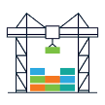

Operation Progress
90
%
Container terminals relies on fixed facts to increase the terminal throughput, reduce delays, improve stability, operational cost reduction, workforce training, increase safety awareness, reduce congestion and saving time and resources.
We could achieve all the above by utilizing GTAP system in organizing all the port activities and pre-planning.
Reducing accidents by increasing safety awareness and conducting training
80%
Reduced the container vessel congestion from Shuaiba port by increasing berth productivity.
65%
Increased the operation productivity by utilizing the right TOS (GTAP)
33%
Reduced the TTO (Truck Turn around) by improving gates.
40%
Improved the terminal space management by improved planning.

Slide 16
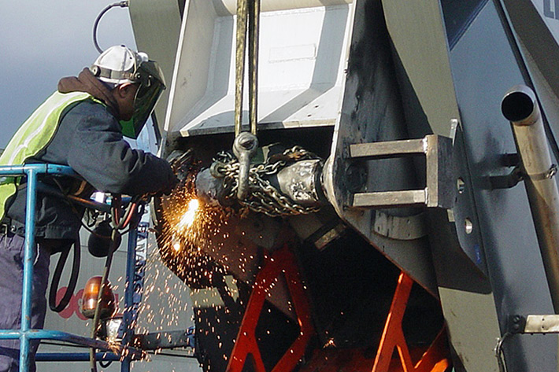
Maintenance

Slide 17
Maintenance
Overview on GCS equipment’s maintained
Equipment | OEM | Quantity | Age | SWL
11 KV Substation | KCEC | 1 | 9 years | -
Ship to shore cranes | Liebherr | 7 | 8 years | SL -40T, TL -65T, H-75T
Rubber tired gantry cranes | Liebherr | 20 | 8 years | Single lift 40 ton
Empty container handlers | Kone cranes | 19 | 8 years
Reach Stackers | Kone cranes | 5 | 8 years | 40 ton
Terminal tractor trailer | KALMAR | 38 | 8 years
Terminal tractor trailer | TERBERG | 25 | 9 years

Slide 18
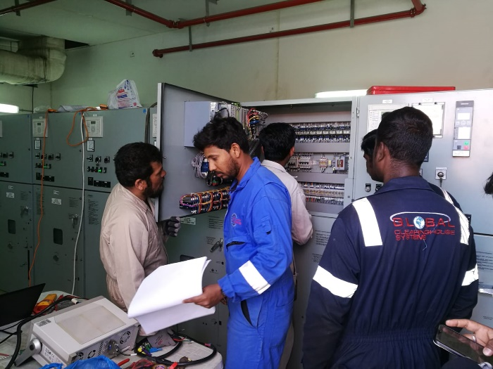
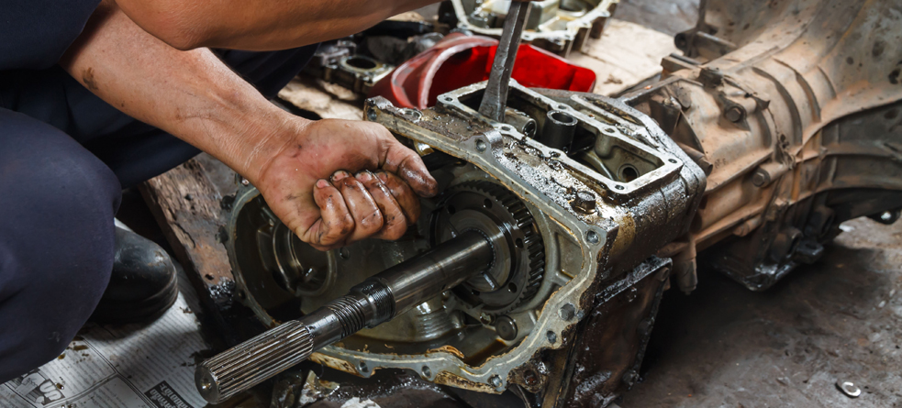
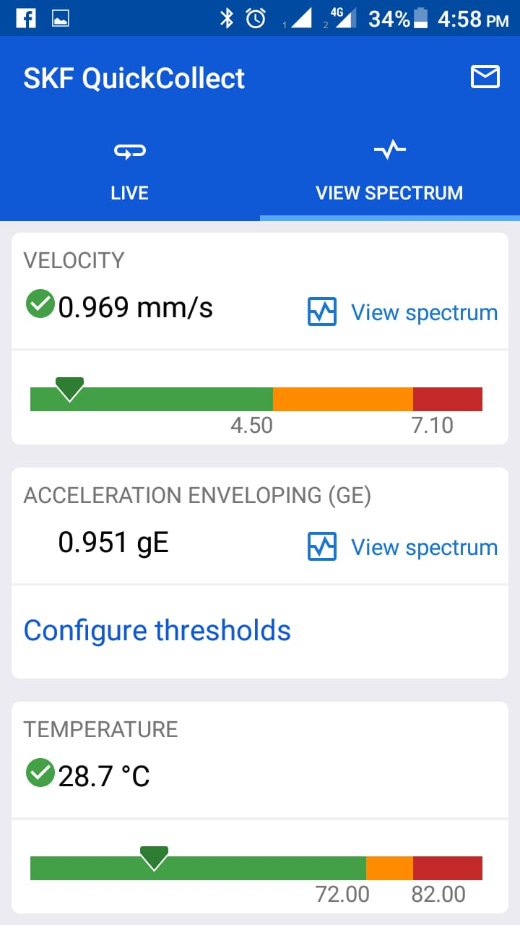
Maintenance
Maintenance of Substation
Our team carrying out relay settings on the 11 KV incomer
Repair job at workshop
Condition monitoring

Slide 19
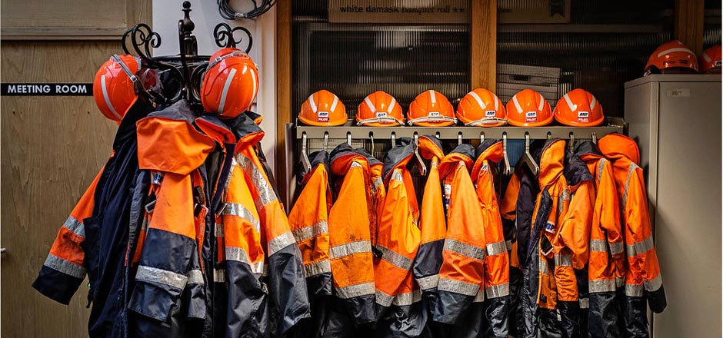
Safety
and
Security

Slide 20
Safety and Security
We are committed to providing safe and healthy working environments for our employees
Reduce and prevent injuries by developing safe working practices to all staffs
Promote health, safety, and environmental protection as an integral part of management duties
Supply appropriate information, instruction, and training to promote awareness of health, safety,
and environmental concerns – and of the responsibility of each employee to prevent injury to themselves and others
Comply with all laws and regulations covering occupational health and safety, and the environment
Develop and implement policies and procedures designed to promote safe working practices and
environmental protection
Implement practices and procedures for the safe use, handling, storage, and transportation of all
materials and substances

Slide 21
Safety and Security
As per SOLAS, IMDG containers will segregated as per the class.
According to yard structure each class of IMDG will stack separately and not mix with one another
Easy access for IMDG containers and fire fighting incase any damage caused
Restricted classed will discharged on Direct delivery basis

Slide 22

Training

Slide 23
Training
Training Schedule
Title | Operations | Maintenance | Safety | Documentation
Safety and Regulations | ✔ | ✔ | ✔ | ✔
General Port Operations | ✔ | ✔ | ✔ | ✔
Equipment operations | ✔ | X | ✔ | X
Transferring Containers | ✔ | X | X | ✔
System and procedures | ✔ | ✔ | ✔ | ✔
Maintenance | X | ✔ | X | X
Safety Management
Operations
Preparation for emergency situations
Safety
Physical distribution safety

Slide 24
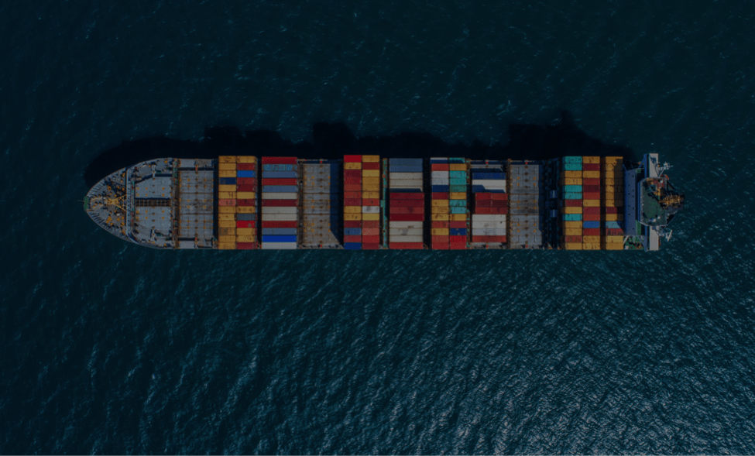
Statistics

Slide 25
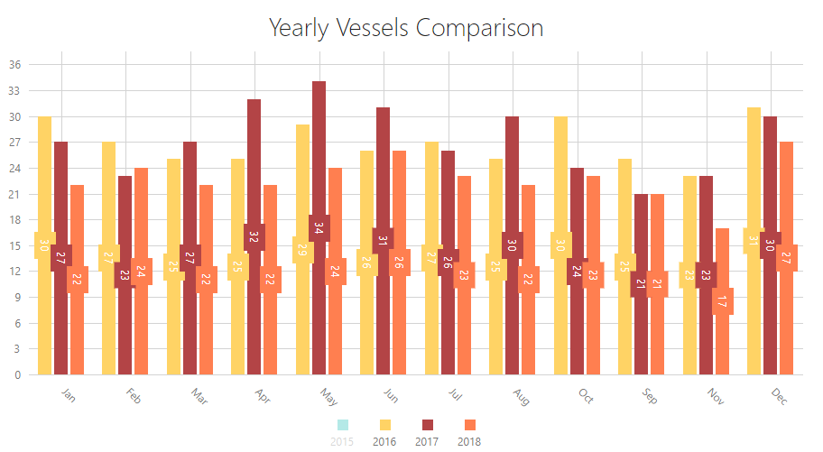
Statistics

Slide 26
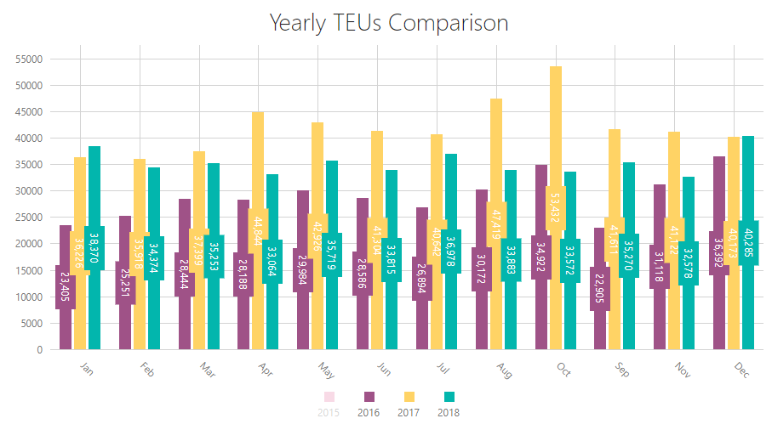
Statistics

Slide 27
Statistics
Truck Turn-around Time
The amount of time taken to complete a process or fulfill a request. The concept thus overlaps with lead time and can be contrasted with cycle time.

Slide 28
REVENUE

Slide 29
Revenue

Slide 30

Future Ideas
Automation of Gates
Plates and container number recognition.
Automation of Port Equipment
Containers and damages recognition.
Utilizing IOT in connection to cranes.
Automation of Terminal Process
Integration between GTAP and container terminal stakeholder’s systems.

Slide 31
THANK YOU
YOU THINK OF PORTS? WE HAVE SOLUTIONS

